Slide 1
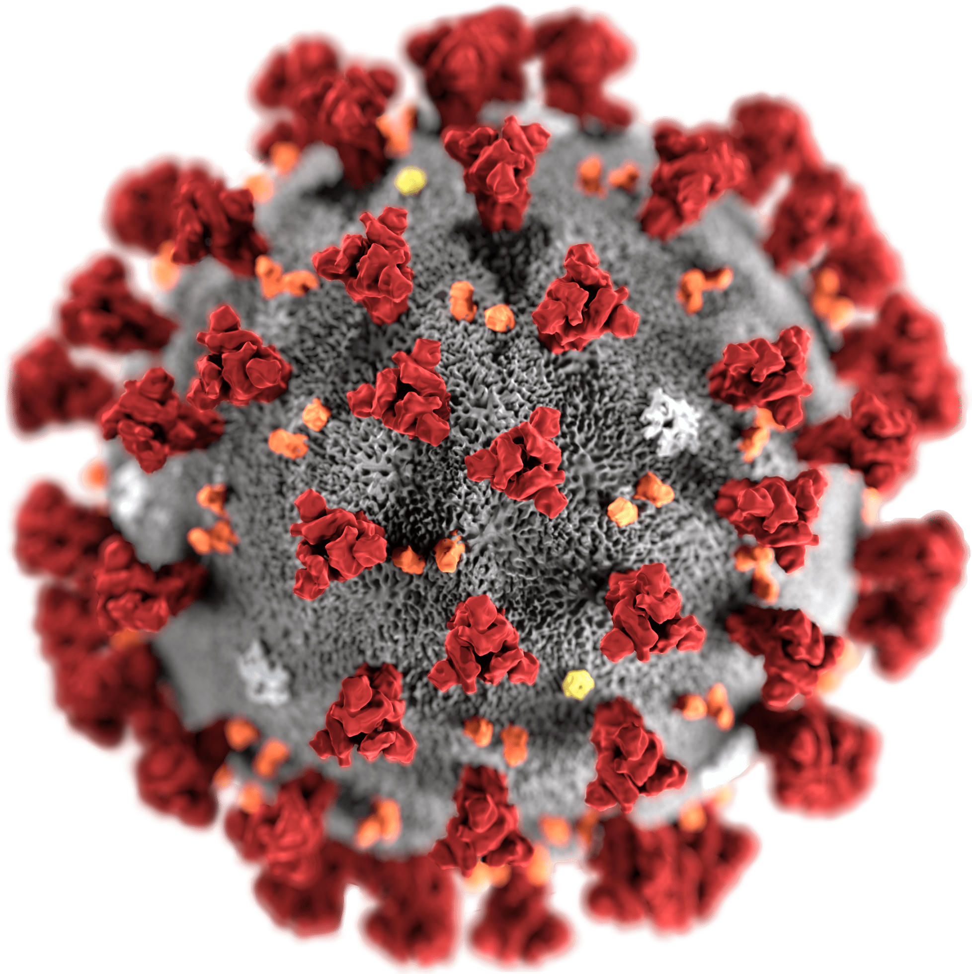
COVID-19 in the US
Anthony Costa, Jonathan Diaz, Sarah Kim, Aakash Nagalapura

Slide 2
Covid Act Now API
We extracted data from the Covid Act Now API to analyze both past and current COVID trends. We can see the severity of the pandemic reflected in the growing number of cases and death. With public health measures such as vaccine rollout, we can see shifts in the data.

Slide 3
Using Flask

Slide 4
Taking a closer look at New Jersey..
By comparing charts between each state, we see a trend between the rate of Bivalent boosters administered and the percentage of positive test results and deaths.

Slide 6
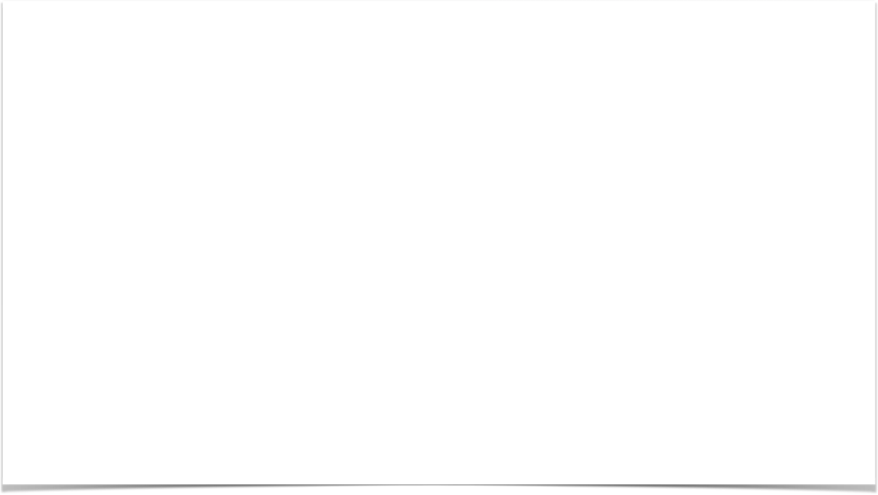
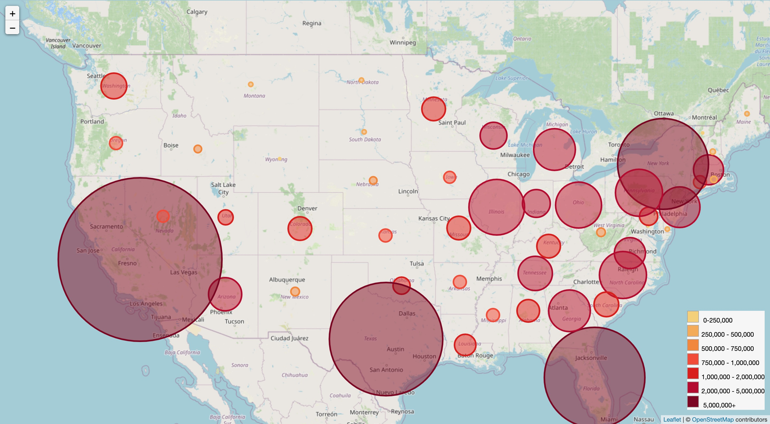
Across the Entire Country
Looking at the overall population, we can see trends between the population density, vaccination rates, and mortality rates.

Slide 7
Limitations
For this particular data set..
There was no information provided on the different variations or strands of COVID.
There was entire year of deaths before vaccines were approved and started becoming available to the general public.

